Slide 1
OVERVIEW OF ASP.NET CORE

Slide 2
Important Features
Cross platform compatibility
Flexibility of being open source
Built-in support for dependency injection
Support for JSON based configuration

Slide 3
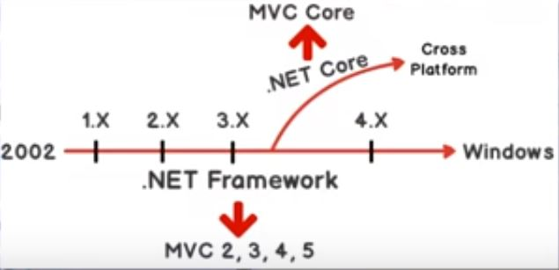
.NET Framework and MVC Core

Slide 4
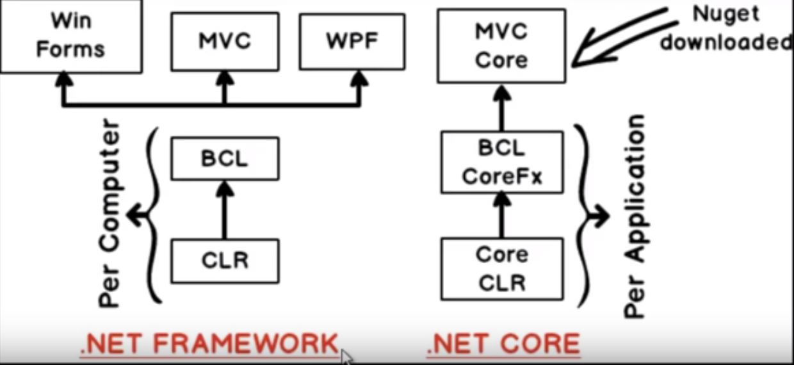
.NET Framework and MVC Core

Slide 5
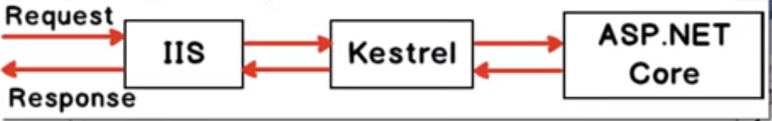
IIS and Kestrel

Slide 6
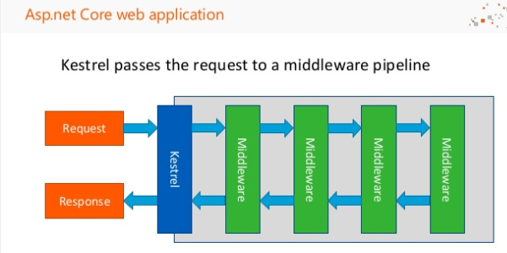

Slide 7
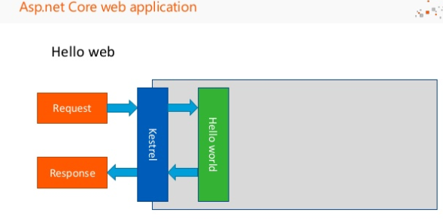

Slide 8
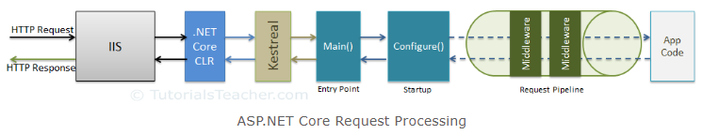
ASP.NET Core - Middleware

Slide 9
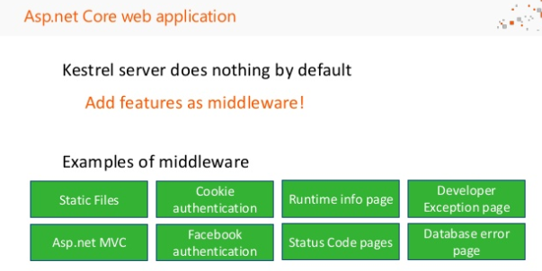

Slide 10
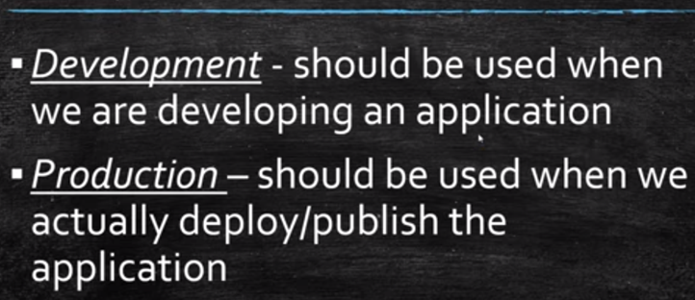
Development and Production

Slide 11
Development and Production
IsDevelopment() & IsProduction()
In which environment is the app running?
What happens when we are in production?

Slide 12
Entity Framework Core*
The Future of EF for ASP.NET Core

Slide 13
DB-Driven Web Applications
Web App
Internet
ORM
Database
Users

Slide 14
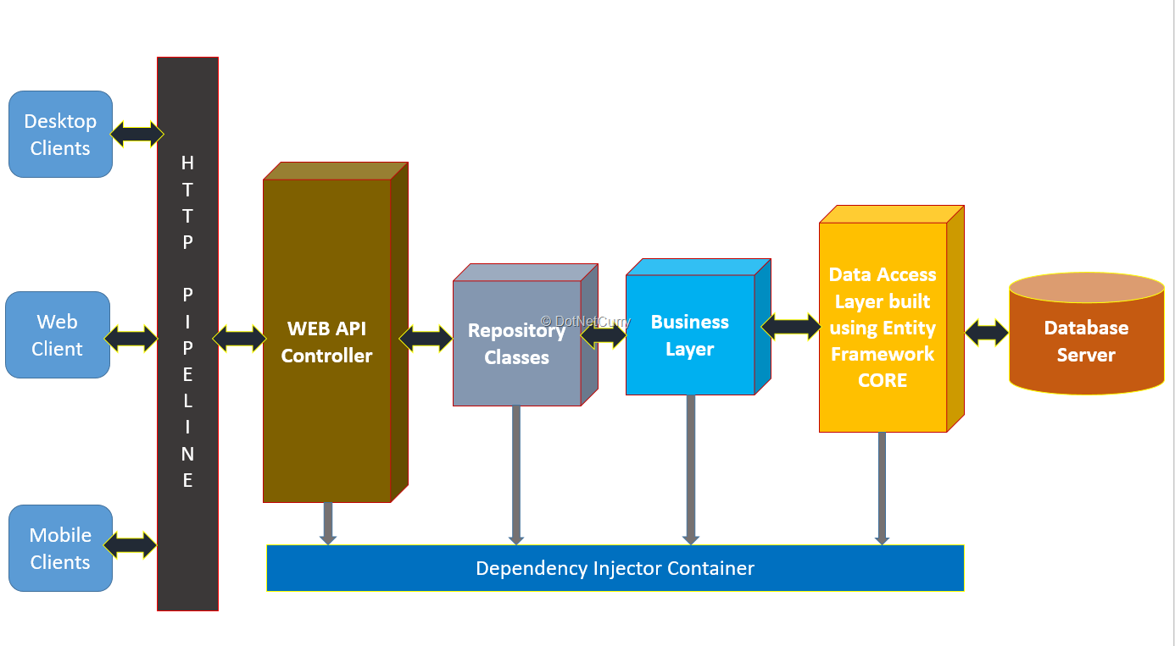

Slide 15
SQL Server

Slide 16
Performance Tuning in SQL Server

Slide 17
SQL Server Profiler
SQL Server Profiler:
It can be used to monitor and capture events occurring in SQL Server. It can help identify performance issues by capturing SQL statements, duration, and other relevant information.

Slide 18
Execution Plans
SQL Server provides the ability to view the execution plans of queries, which can help identify performance bottlenecks and suggest ways to improve query performance.
You can use the "Include Actual Execution Plan" options in SSMS to view these plans.

Slide 19
Indexing
Proper indexing is crucial for query performance.
SQL Server provides tools like the Database Engine Tuning Advisor (DTA) and the Index Tuning Wizard in SSMS to help identify and create missing indexes.

Slide 20
Query Optimization
Writing efficient queries is essential for good performance.
Techniques such as avoiding unnecessary joins, using appropriate WHERE clauses, and minimizing the use of functions in the WHERE clause can help improve query performance.

Slide 21
Query Optimization
SELECT fields instead of using SELECT *
Avoid SELECT DISTINCT
Create queries with INNER JOIN (not WHERE or cross join)
Use WHERE instead of HAVING to define filters
Use wildcards at the end of a phrase only
Use LIMIT to sample query results
Run your query during off-peak hours

Slide 22
MongoDB

Slide 23
Introduction
MongoDB is an open-source document database.
Falls into the category of NOSQL databases
• Stores the data in un-normalized format
• Data is stored as collections of documents

Slide 24
Document database
A record in an RDBMS is equivalent to a
document in MongoDB
– A data structure composed of field and value pairs.
• MongoDB documents are similar to JSON objects.
– The values of fields may include scalar data, other
documents, arrays, and arrays of documents.
– Internally, MongoDB stores these documents in the
binary format, called BSON (Binary JSON)

Slide 25
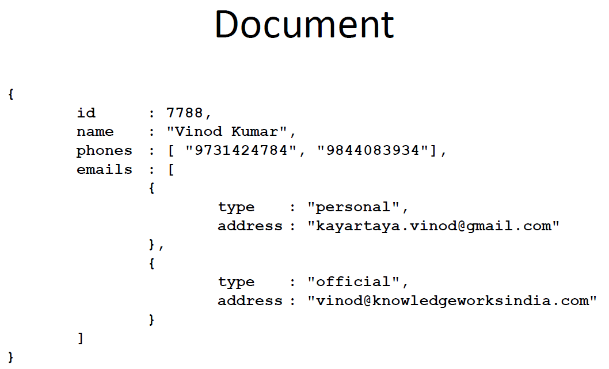

Slide 26
Advantages
• Documents correspond to native data types in
many programming languages.
• Embedded documents and arrays reduce need
for expensive joins.
• Dynamic schema supports fluent polymorphism.

Slide 27
High performance
• Support for embedded data models reduces
I/O activity on database system.
• Indexes support faster queries and can include
keys from embedded documents

Slide 28
High availability
• MongoDB’s replication facility, called replica
sets, provide:
– automatic failover.
– data redundancy.
• A replica set is a group of MongoDB servers
that maintain the same data set, providing
redundancy and increasing data availability

Slide 29
Automatic scaling
• MongoDB provides horizontal scalability as
part of its core functionality.
– Automatic sharding distributes data across a
cluster of machines.

Slide 30
Installation/setup
Download the binary for your operating
system
– For Windows 64bit:
• https://fastdl.mongodb.org/win32/mongodb-win32-
x86_64-2008plus-2.6.0.zip
• Unzip to a drive
– In my computer:
• D:\mongodb-win32-x86_64-2008plus-2.6.0

Slide 31
Installation/setup
Add the D:\mongodb-win32-x86_64-
2008plus-2.6.0\bin to your PATH variable

Slide 32
Default DB location
• MongoDB requires a data directory to store all
data.
• MongoDB’s default data directory path is
\data\db.
– You can create this folder structure in the same
drive as mongodb’s installation drive
– Or specify another location when starting the
server

Slide 33
Starting the server
• The server can be started by running the
mongod.exe executable
• Some of the useful options are:
--dbpath=PATH-TO-YOUR-DB
--port=27017
• Example:
mongod --dbpath=d:\mongodb-data
(Note: you must create the folder manually before running
this command)

Slide 34
JavaScript Shell
The executable “mongo.exe” provides an
interface to issue direct commands on the db.
• By default the “mongo” command tries to
connect to “localhost” and port “27017”
• You can connect to different ones using --host
and --port options:
Mongo --port 12345 --host ramnath_homepc

Slide 35
Some commands to start with..
• show dbs
– displays the list of databases
• use mydb
– switches to the database “mydb” if exists, or creates a new with the same name and switches to it
• db
– displays the current database in use
• db.dropDatabase()
– Deletes the current database

Slide 36
Some commands to start with..
db.<collection>.findOne()
– Displays the first document in the collection
• db.<collection>.find().pretty()
– displays the first 20 documents in an indented format

Slide 37
Some commands to start with..
• show collections
– Displays the list of collections (tables in RDBMS)
• db.<collection>.insert(data)
– If the collection exists, inserts the data, else
creates a new collection with the same name and
inserts the data

Slide 38
Some commands to start with..
db.<collection>.find()
– Returns a cursor to the result
– Displays the first 20 documents on the screen
– type “it” to iterate again and get 20 more
documents

Slide 39
Some commands to start with..
Since “mongo.exe” is a JavaScript shell, you
can use a script to process the cursor returned
by the find() method
var d = db.salesdata.find(); // returns the cursor
// now loop through the cursor to get one document at a time
while(d.hasNext()){
var s = d.next();
print(s.date + " >> " + s.area + " Rs." + s.sales);
}

Slide 40
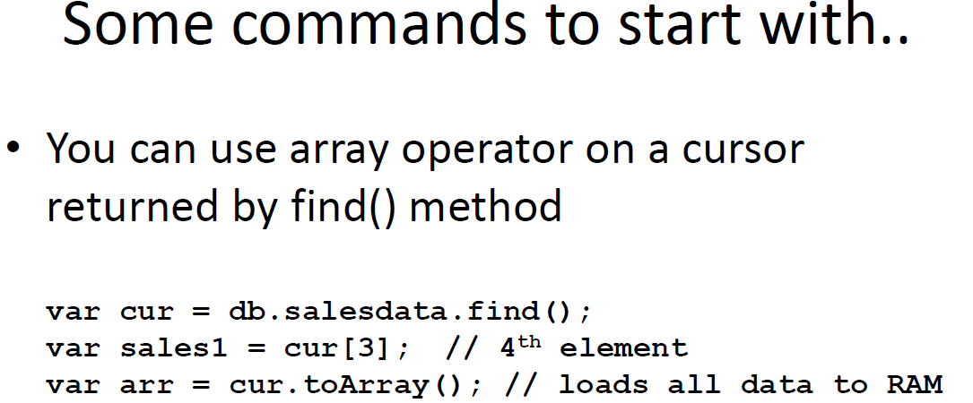

Slide 41
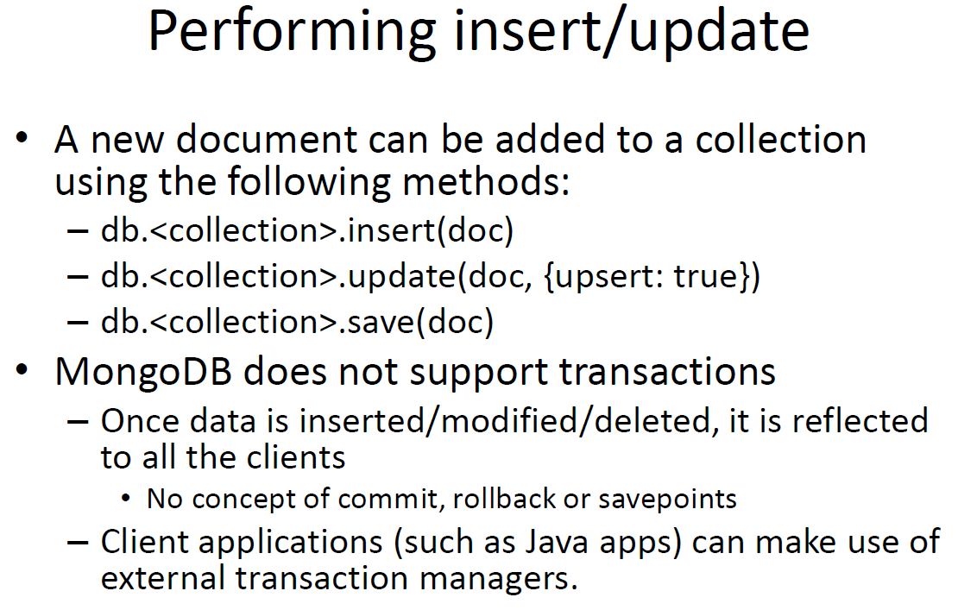

Slide 42
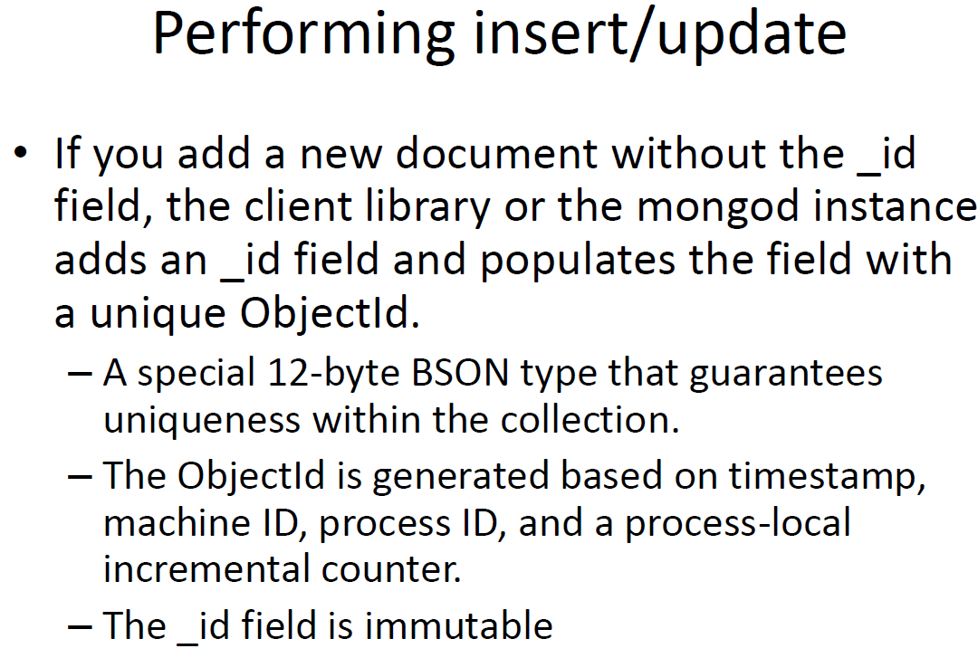

Slide 43
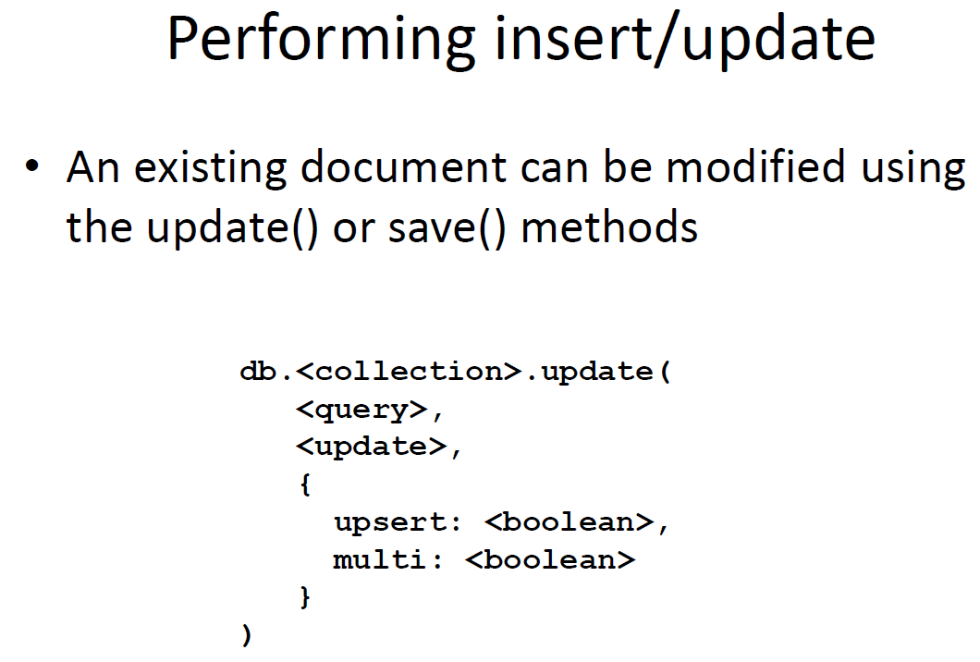

Slide 44
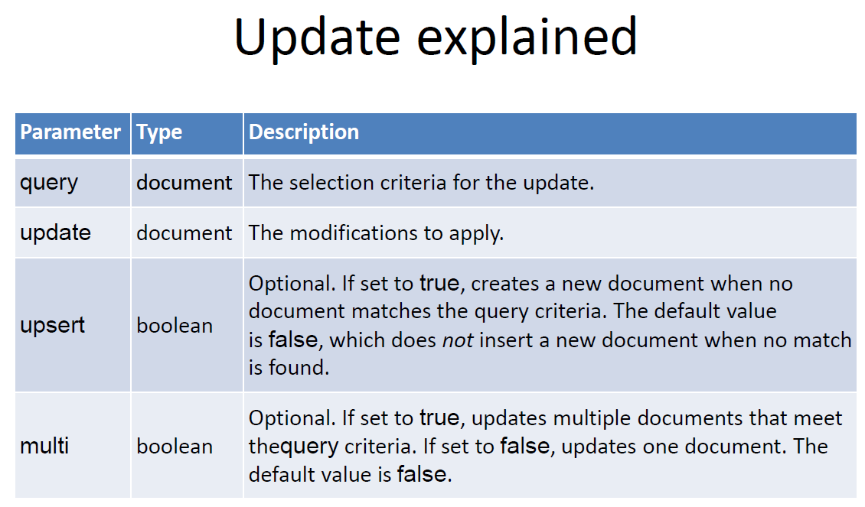

Slide 45
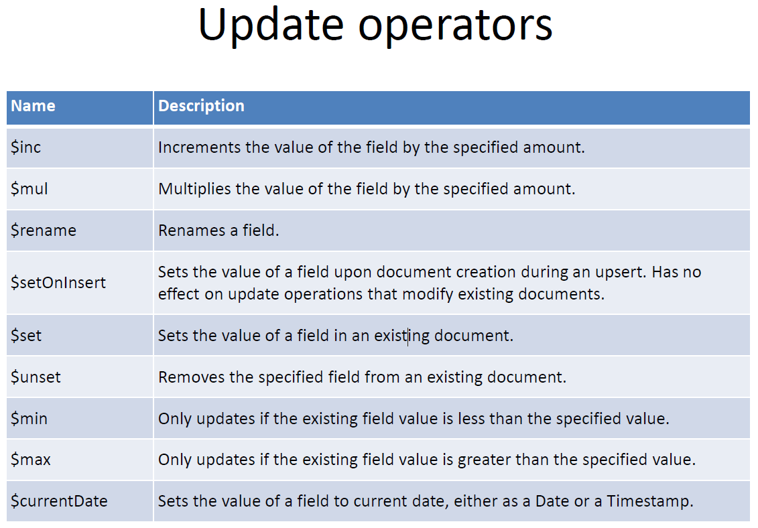

Slide 46
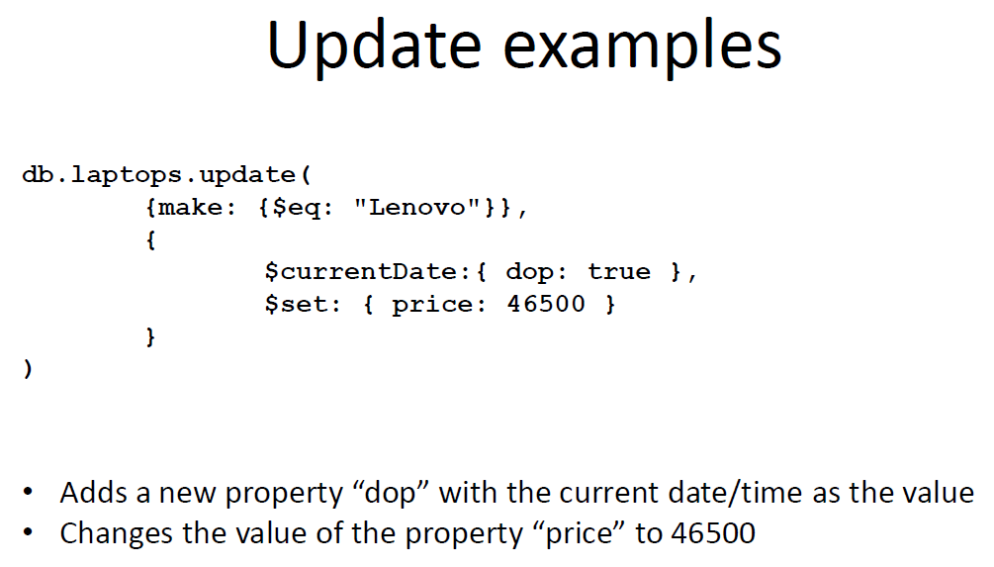

Slide 47
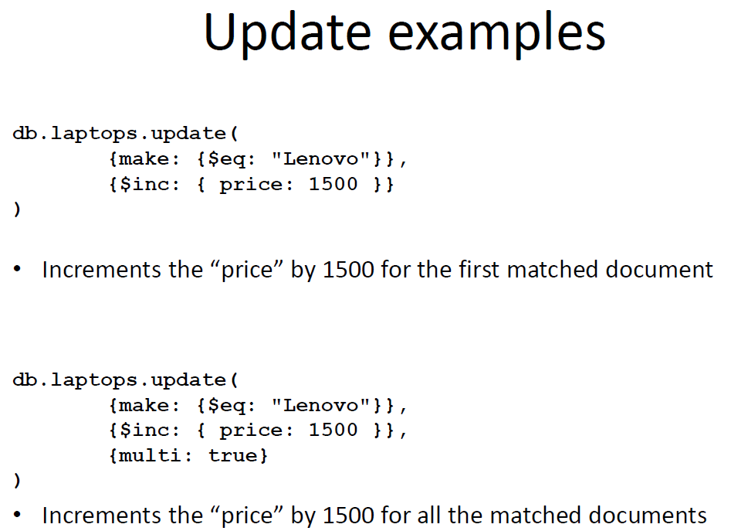

Slide 48
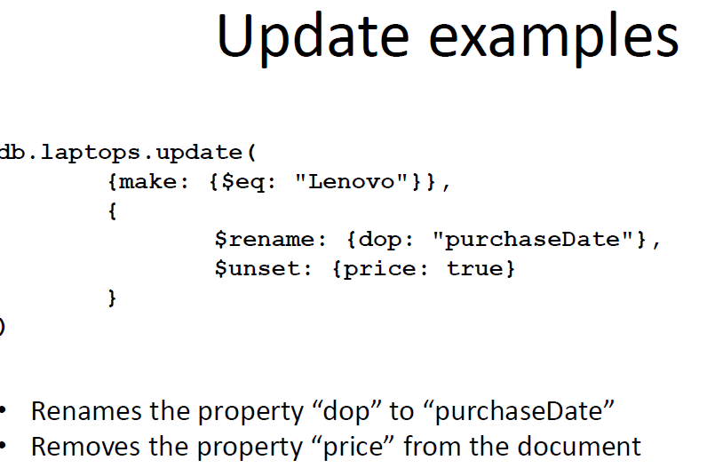

Slide 49
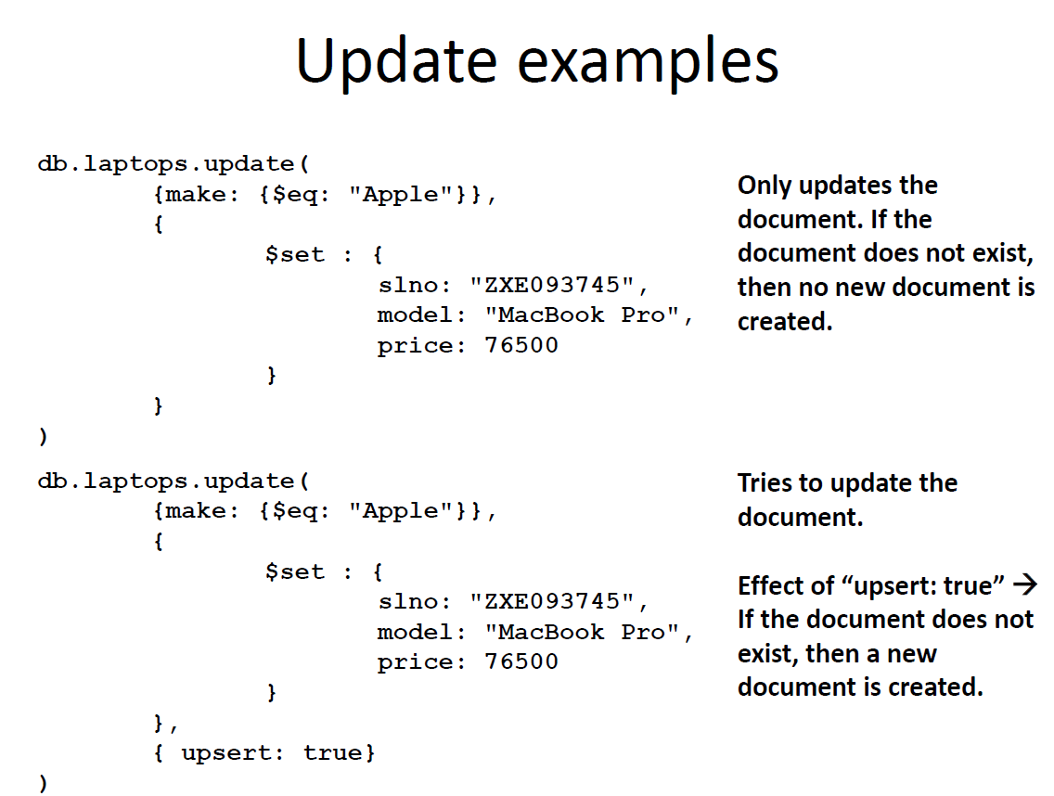

Slide 50
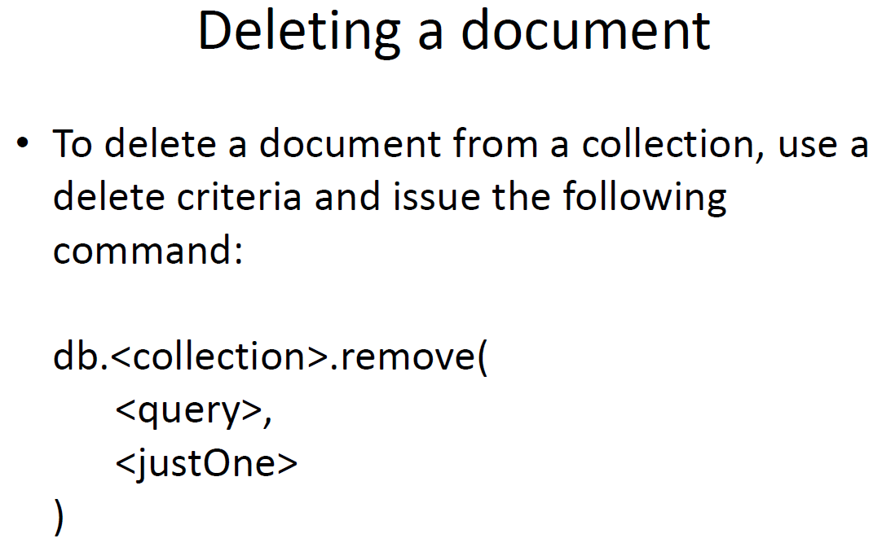

Slide 51
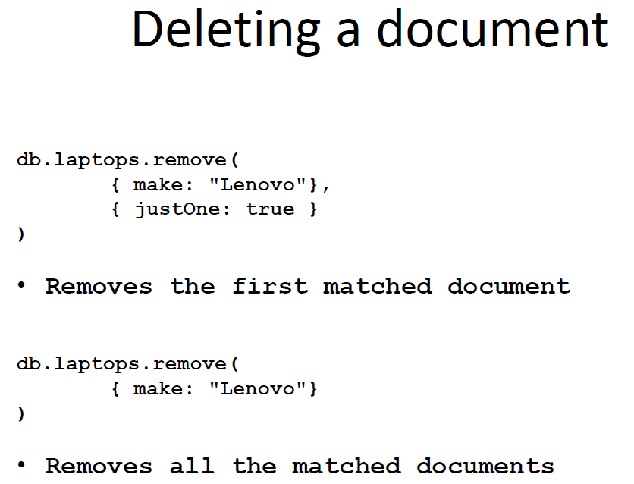

Slide 52
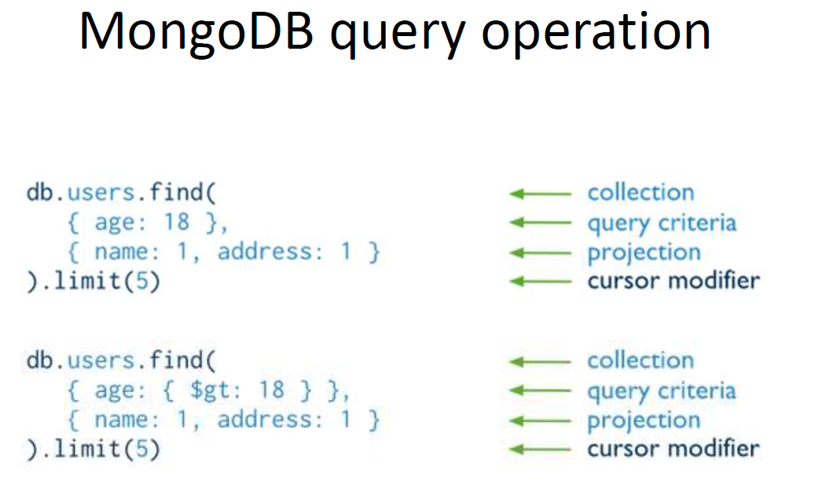

Slide 53
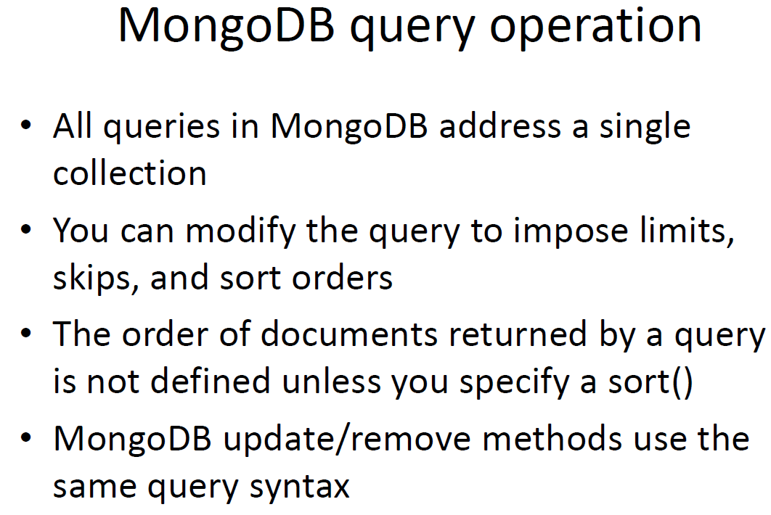

Slide 54
Ordering the query results
Use the sort() method to achieve it
db.orders.find({“customer.customer_id”: "ANTON"})
.sort({order_date: 1})

Slide 55
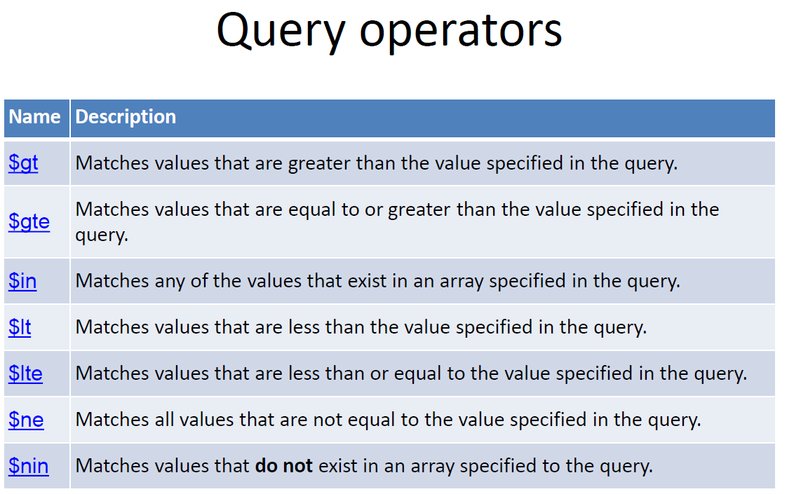

Slide 56
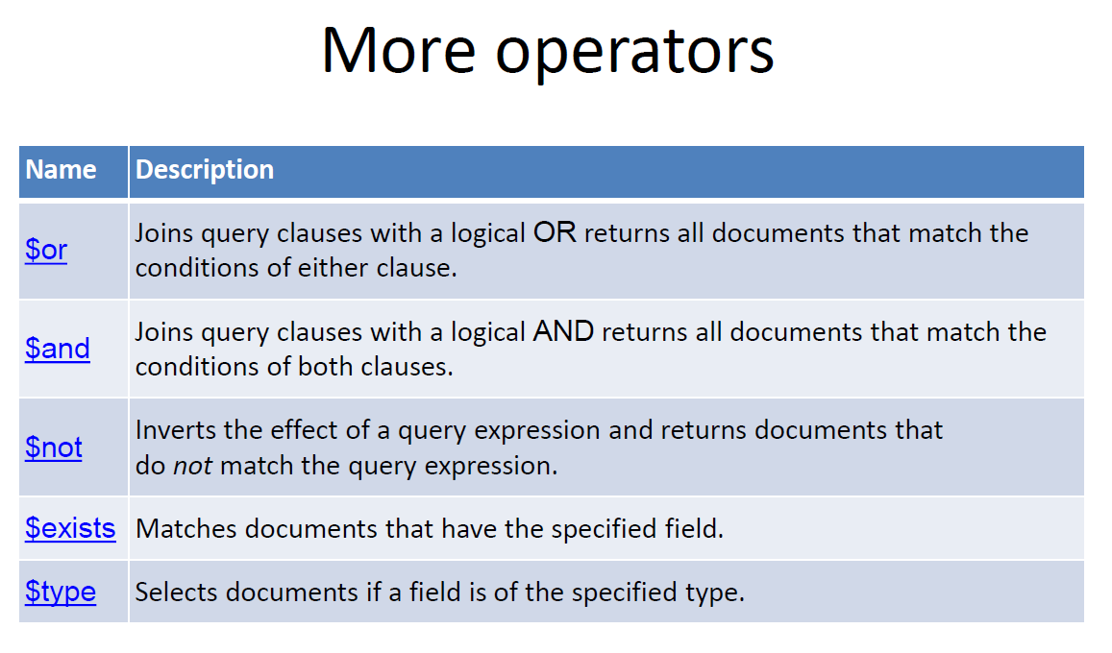

Slide 57
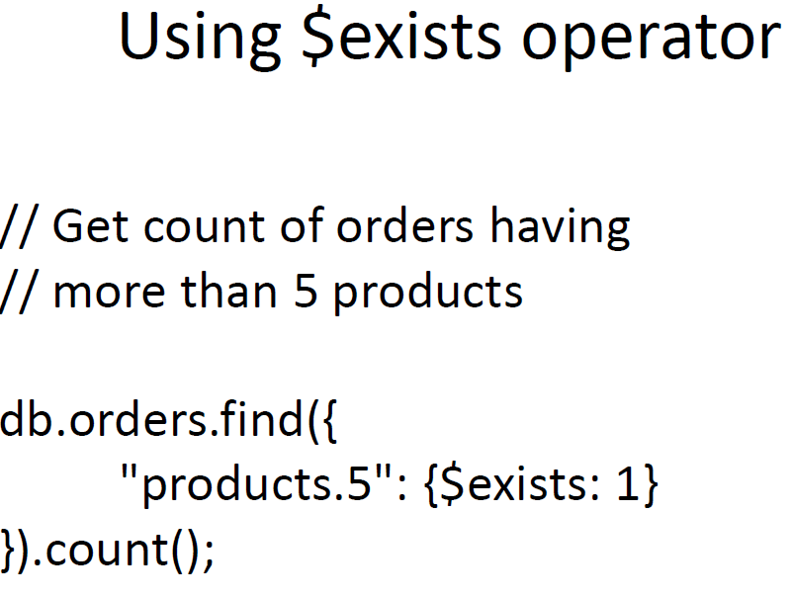

Slide 58
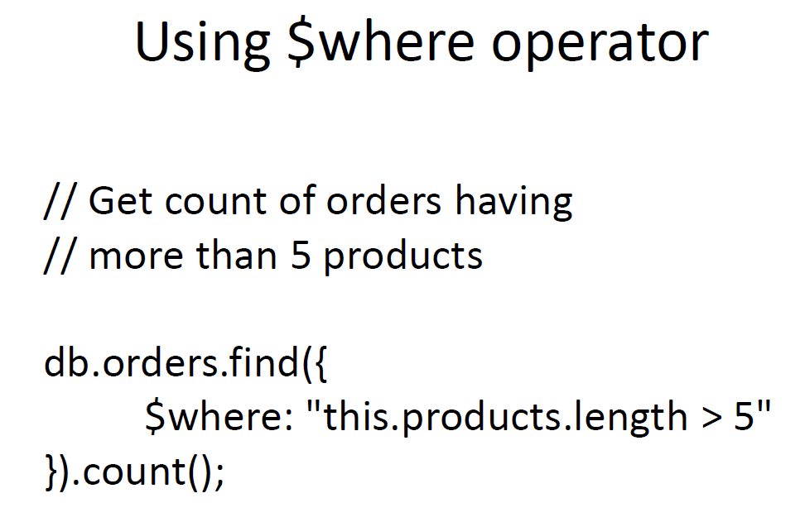

Slide 59
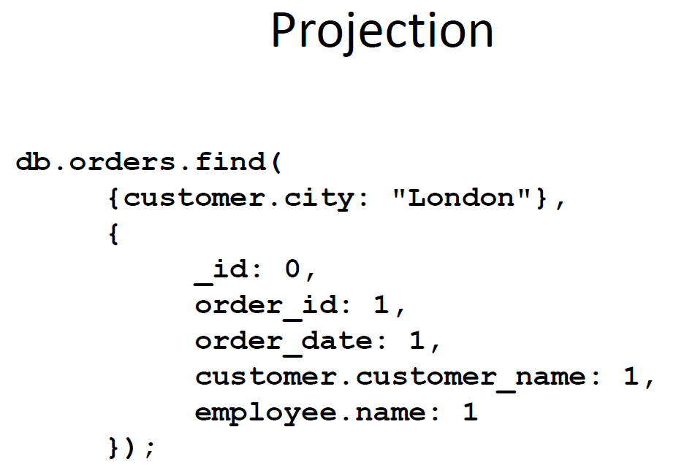

Slide 61
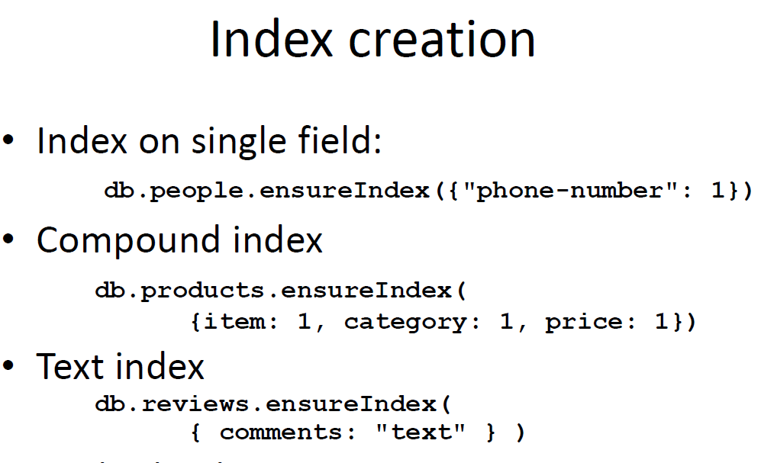

Slide 62
Sharding
• Storing data across multiple machines.
• MongoDB uses sharding to support
deployments with
• very large data sets and
• high throughput operations

Slide 63
Problems
Database systems with large data sets and high throughput applications can challenge the capacity of a single server.
– High query rates can exhaust the CPU capacity of
the server.
– Larger data sets exceed the storage capacity of a
single machine.
– Working set sizes larger than the system’s RAM
stress the I/O capacity of disk drives.

Slide 64
Solution 1
Vertical scaling
– Increase capacity by adding more CPU and storage
resources
• Limitations: high performance systems with large
numbers of CPUs and large amount of RAM are
disproportionately more expensive than smaller
systems

Slide 65
Solution 2
Sharding
– Horizontal scaling
– Divides the data set and distributes the data over
multiple servers, or shards.
• Each shard is an independent database,
• Collectively, the shards make up a single logical
database.

Slide 66
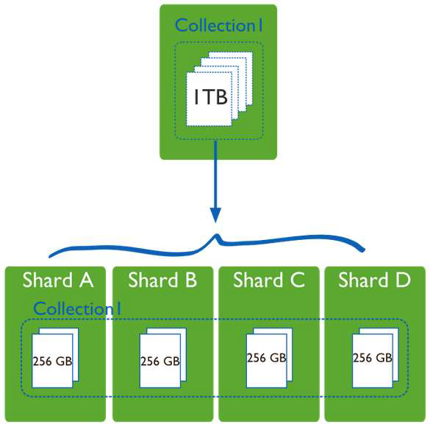
Sharding

